Slide 1







CLOUDLY: ONLINE PERFUME STORE
FRONTEND FINAL PROJECT
Presented by
Akhmet Z. – Brands & Catalog
Sultan K. – Product Pages
Erulan T. – Authentication & Profile
Bekzat Z. – Welcome & Contact Pages

Slide 2


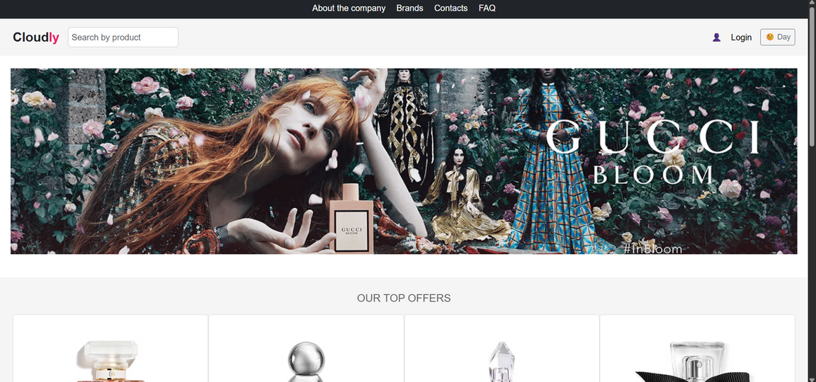
INTRODUCTION
PROJECT OVERVIEW
“CLOUDLY IS A MULTI-PAGE PERFUME STORE WEB APP THAT ALLOWS USERS TO EXPLORE FRAGRANCE BRANDS, VIEW PRODUCTS, AND MANAGE PERSONAL PROFILES.”
Responsive multi-page web app
Built with HTML, CSS, JS
Integrated Pexels API for dynamic perfume imagery

Slide 3




TECHNOLOGIES USED
Structure: HTML — provides the page layout and content organization.
Styling: CSS — responsible for responsive design and overall visual appearance.
Logic: JavaScript — adds interactivity, form validation, and dynamic functionality.
API: Pexels API — delivers high-quality perfume-related images dynamically.
Hosting: GitHub Pages / Netlify — used for project deployment and live presentation.

Slide 4
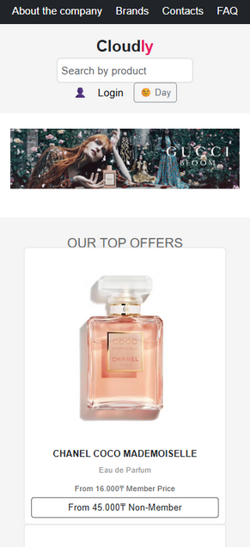
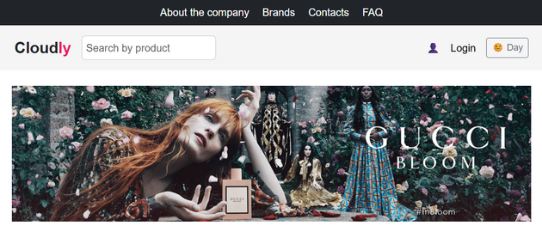
RESPONSIVENESS &
DESIGN QUALITY
Fully responsive layout (desktop, tablet, mobile).
Elegant luxury aesthetic — minimalism, balance, and brand consistency.
Clean typography and color palette (gold, beige, white).
“ADAPTIVE DESIGN WITH CONSISTENT USER EXPERIENCE.”

Slide 5

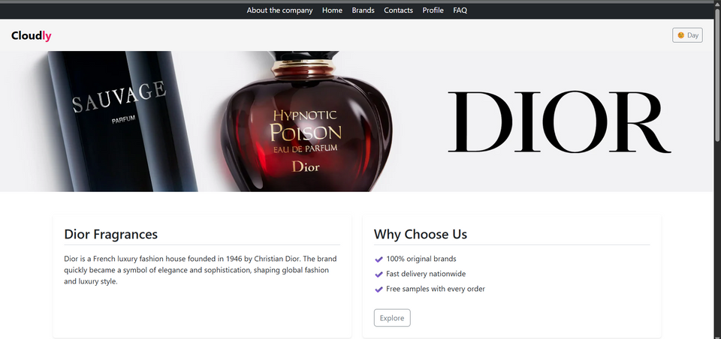
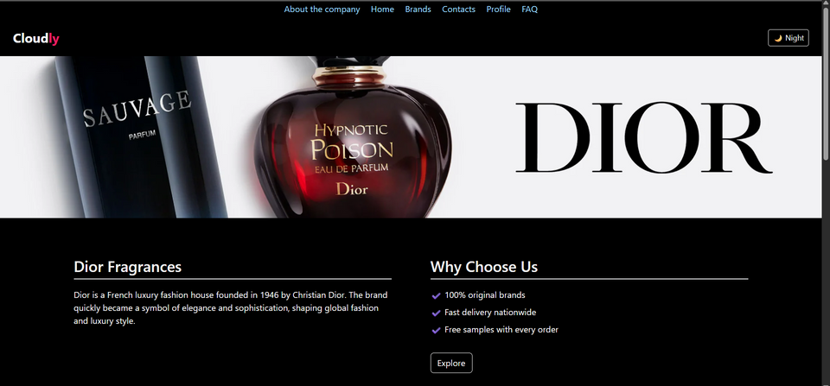
LIGHT & DARK
MODES
Users can toggle between light and dark modes.
Preferences saved in localStorage.
Colors adjust for readability and contrast.
“DARK MODE IMPLEMENTED ACROSS ALL PAGES.”

Slide 6


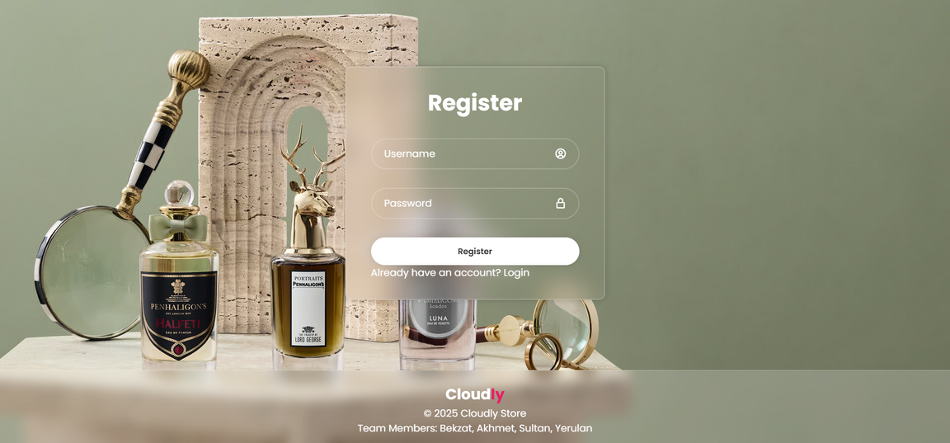
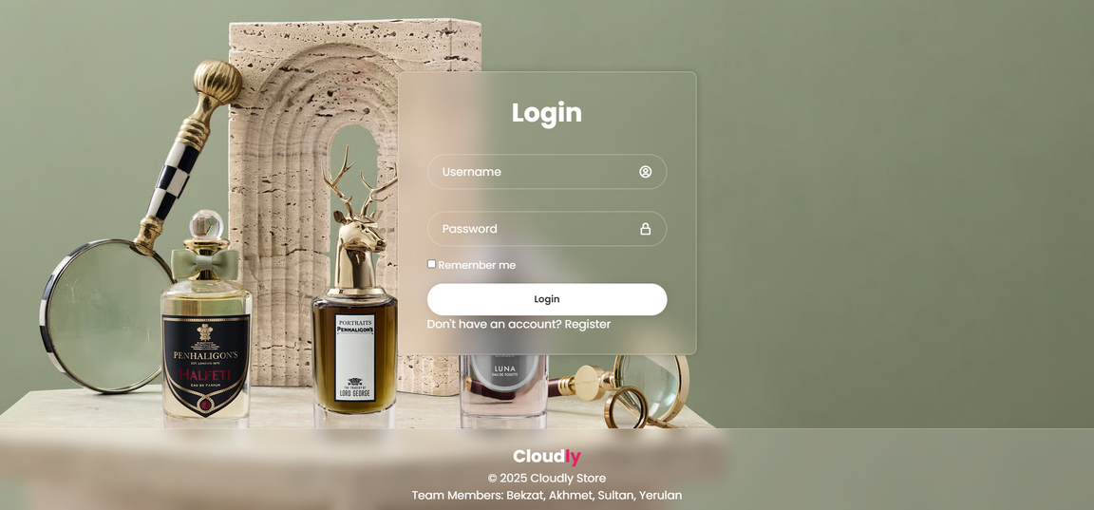

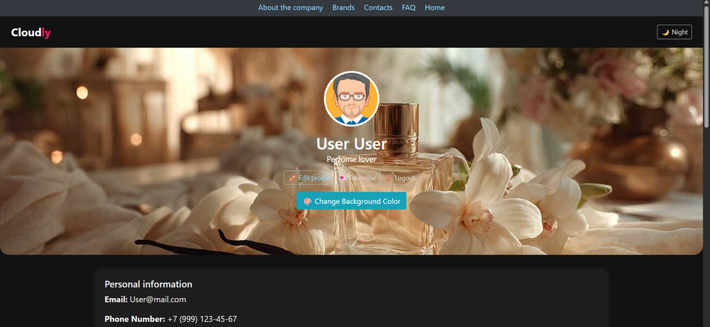
AUTHENTICATION &
VALIDATION
Sign Up & Login forms (stored in LocalStorage).
Input validation: name, email, password, required fields.
Profile page shows saved user data with editing option.
“CLIENT-SIDE AUTHENTICATION AND VALIDATION.”

Slide 7

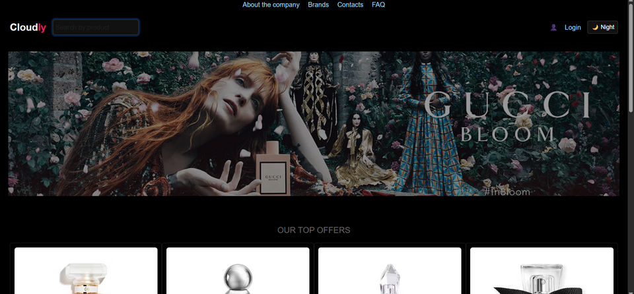
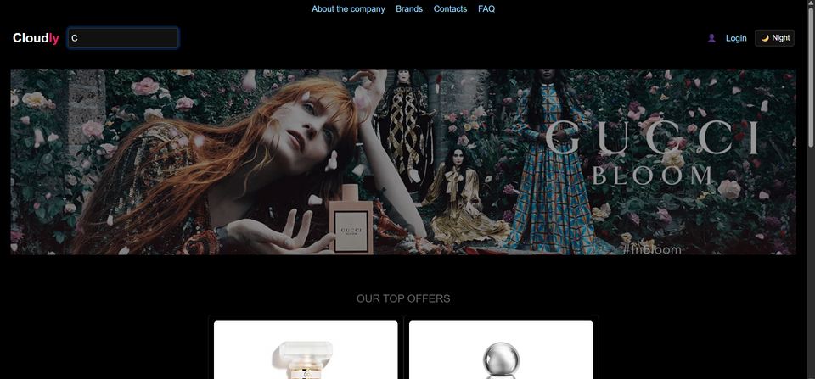
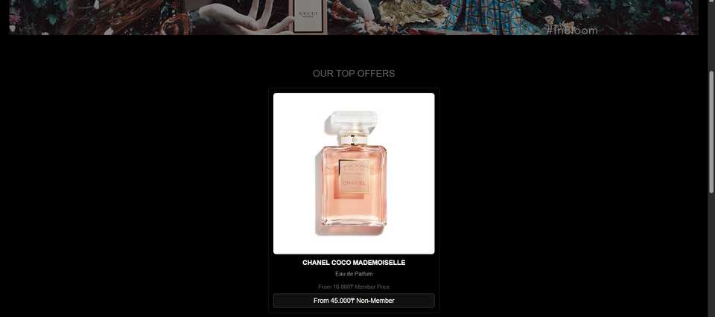
SEARCH &
FILTRATION
Search bar lets users find perfumes by name or brand.
Filtered results appear dynamically and are stored locally.
All buttons and interactions are functional.
SEARCH AND FILTER IMPLEMENTED WITH JAVASCRIPT.”

Slide 8
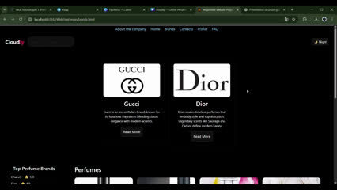
CREATIVE
ANIMATIONS
Smooth hover effects on buttons (shadow, ripple).
Image zoom animation on hover.
Soft fade-in text transitions.
“INTERACTIVE VISUALS FOR PREMIUM EXPERIENCE.”

Slide 9
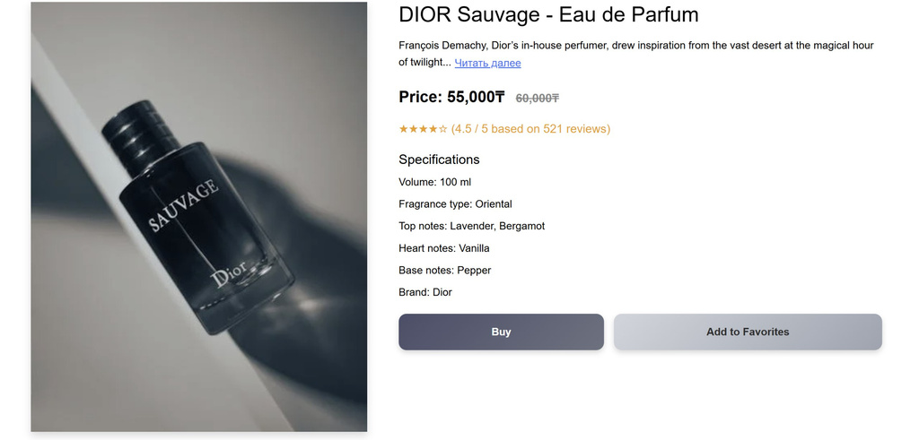
EXTERNAL API
INTEGRATION
Integrated Pexels API for perfume-related imagery.
Fetches high-quality, dynamic visuals into catalog and product pages.
Demonstrates external data handling with async JS.
“DYNAMIC CONTENT POWERED BY PEXELS API.”

Slide 10

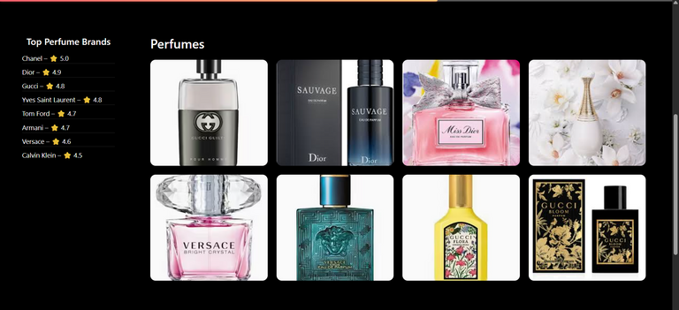


CONCLUSION &
REFLECTION
Future Improvements:
Real backend authentication
Shopping cart feature
Multilingual interface
“CLOUDLY DEMONSTRATES HOW MODERN WEB TECHNOLOGIES CAN CREATE IMMERSIVE AND FUNCTIONAL DIGITAL EXPERIENCES.”

Slide 11


Thank
You
For Your Attention

